Slide 1
Estimated Payment Date
David Chi
2016-07-18

Slide 2
Outline
Invoice Payment Cycle
Forecasting Future Payment Date
Populating Data for Supplier Collaboration tool
Supplement: Decision Tree Background

Slide 3
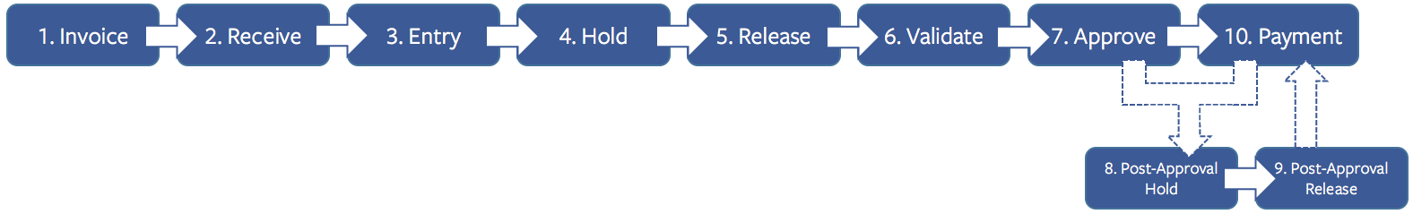
Invoice Payment
Invoice payment follows a multi-step process.
Median cycle times for each step (days):

Slide 4
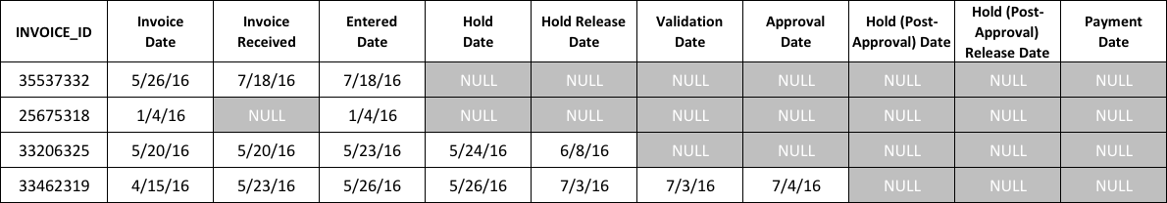
Forecasting Future Payment Date
Any given invoice will have data up to the last step it has completed.
Forecast payment date based on existing data.
Sample Data:

Slide 5
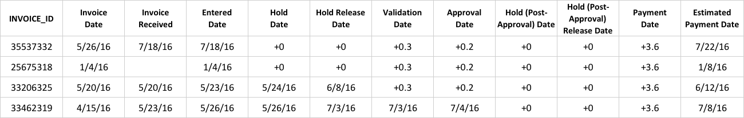
Forecasting Future Payment Date
Zeroth-order forecast:
Take the last milestone completed and add the median times for the remaining steps.

Slide 6
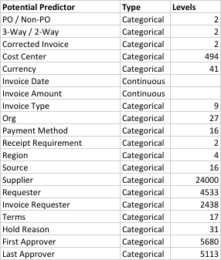
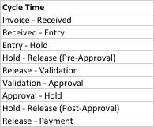

Modeling Cycle Times
Use other invoice data to more accurately predict each cycle time.
For predictors with high number of levels, convert to number of invoices per year.
This places levels with similar number of invoices processed close to each other on a continuous scale.

Slide 7
Modeling Cycle Times
For predictors with high number of levels, convert to number of invoices per year.
This places levels with similar number of invoices processed close to each other on a continuous scale.
Example: Suppliers
24,000 Levels
Convert Supplier to
Count of Invoice ID for Supplier

Slide 8
Modeling Cycle Times
Methodology for Modeling Cycle Time
Read invoice data into R.
Prepare data
Filter rows that do not have data for the Cycle Time being modeled.
Filter outliers in Cycle Time (> 60days)
Create training and test data sets (split data randomly)
Fit Boosted Decision Tree model to training data
Sequence of simple trees where each successive tree is built for the residuals of the preceding tree.
Adjustable parameters:
number of trees (N)
depth of each level (d)
shrinkage factor between levels (λ)
Cycle through range of parameters to identify best model
N: 100, 500, 1000, 2000, 4000
d: 4
λ: 0.001, 0.005, 0.01, 0.1, 0.2, 0.3
Calculate mean square error (MSE) for training and test sets
Repeat for all Cycle Times

Slide 9
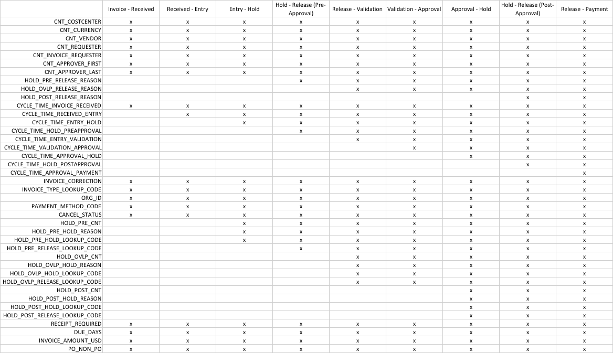
Modeling Cycle Times
Responses
Different predictors used for each response.
Use more data as it becomes available for the later cycle times.
Predictors

Slide 10
Modeling Cycle Times
All Cycle Times tested using all combinations of parameters.
N: 100, 500, 1000, 2000, 4000
d: 4
λ: 0.001, 0.005, 0.01, 0.1, 0.2, 0.3
Combination with lowest test MSE identified for each Cycle Time.

Slide 11
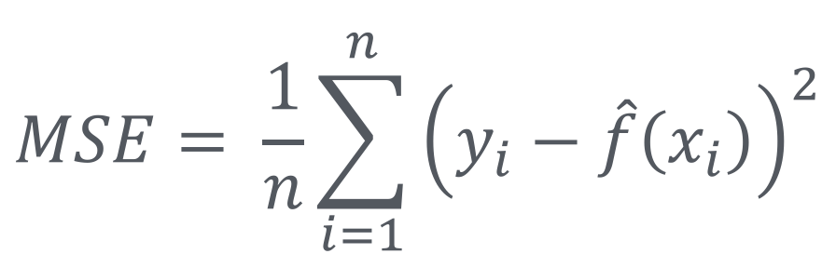

Modeling Cycle Times
Combination with lowest test MSE identified for each Cycle Time.
Quality of fit:
$$MSE= \frac{1}{n}\sum_{i=1}^{n}{{\left(y_{i}−\hat{f}\left(x_{i}\right)\right)}^{2}}$$
Mean square error (MSE) is a measure of how well the model matches the actual data.
$$RMS=\sqrt{MSE}$$
Use root mean square error (RMS) to estimate confidence interval.
$$MSE\left(X±Y\right)=MSE\left(X\right)+MSE\left(Y\right)$$
MSE for combination of random variables is sum of individual MSEs.

Slide 12
Modeling Cycle Times
RMS by location in the invoice payment cycle.
As more steps are known and less steps are estimated the error in the forecast decreases.
When forecasting Payment Date from Invoice Date the RMS is 13.4 days.
When forecasting Payment Date from Approval Date the RMS is 3.7 days.

Slide 13
Populating Estimated Payment Date
Estimating Invoice Payment Date for unpaid invoices
Query all unpaid invoices with predictor values from Oracle
Forecast earliest cycle time (Invoice – Received) where it does not exist
Fill in missing actual values with forecast results
Will use in subsequent cycle time forecasts
Forecast later cycle times in order.
Sum forecasted cycle times to get estimated payment date
Sum MSE to get confidence interval
Adjust Estimated Payment Date using Due Date
Use Due Date as earliest Estimated Payment Date; Do not forecast early payment
Write to table XXFB.XXFB_SC_INV_ESTPAYDATE
Include actual estimate, adjusted estimate, confidence interval
Include metadata (model version, created date, created by)
Save previous estimates to XXFB.XXFB_SC_INV_ESTPAYDATE_ARCHIVE

Slide 14
Populating Estimated Payment Date
XXFB.XXFB_SC_INV_ESTPAYDATE table
Supplier Connect tool can use
INVOICE_ID and ESTIMATED_PAYMENT_DATE.

Slide 15
Decision Tree Background

Slide 16
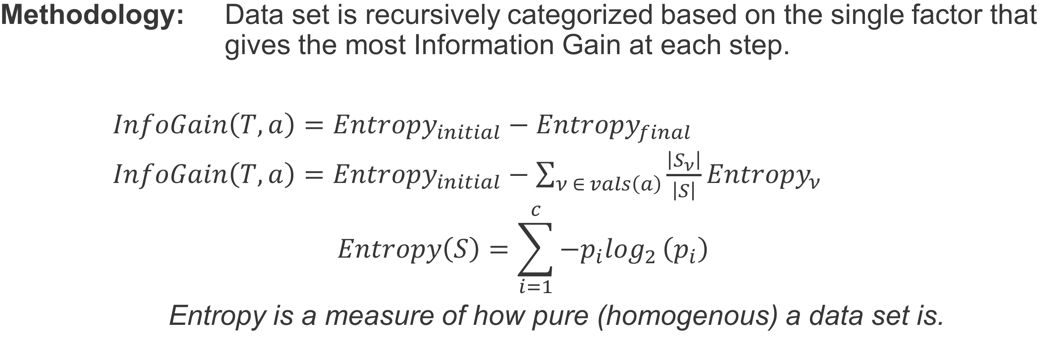
Decision Tree background
Methodology: Data set is recursively categorized based on the single factor that gives the most Information Gain at each step.
$InfoGain\left(T,a\right)={Entropy}_{initial}−{Entropy}_{final}$
$InfoGain\left(T,a\right)={Entropy}_{initial}−\sum_{ν ∈ vals\left(a\right)}{\frac{\left|S_{ν}\right|}{\left|S\right|}}{Entropy}_{ν}$
$$Entropy\left(S\right)=\sum_{i=1}^{c}{−p_{i}\log_{2}}\left(p_{i}\right)$$
Entropy is a measure of how pure (homogenous) a data set is.
High impurity initial state
Low impurity final state using shape to predict color

Slide 17

Decision Tree background
Example: Predicting survival rates of passengers on the Titanic.
Numbers below leaves are probability of survival and percentage of observations in leaf.

Slide 18
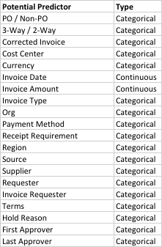
Decision Tree background
Decision Tree is a good fit for predicting Payment Dates because we have a mix of continuous and categorical parameters.

Slide 19
Decision Tree background
Simple Decision Tree using most important predictors for estimating Cycle Time
ORG_ID
INVOICE_AMOUNT_USD
PAYMENT_METHOD_CODE
CNT_VENDOR
tree.invoice=tree(CYCLE_TIME~ORG_ID+INVOICE_AMOUNT_USD+PAYMENT_METHOD_CODE+CNT_VENDOR,ml_data, subset=train, control=tree.control(nrow(ml_data)/2, mincut = 5, minsize = 10, mindev = 0.001))

